Slide 1
Ch.3 Joint Probability Distribution(결합확률분포)
Updated: October 6, 2016
Choi, Kwanghoon
Dept. of Electronics and Computer Engineering
Chonnam National University

Slide 2
This Lecture
Joint Probability Distribution(결합확률분포)
A review
Joint probability Distribution
Conditional Probability Distribution
Expectation in Joint Probability Distribution

Slide 3
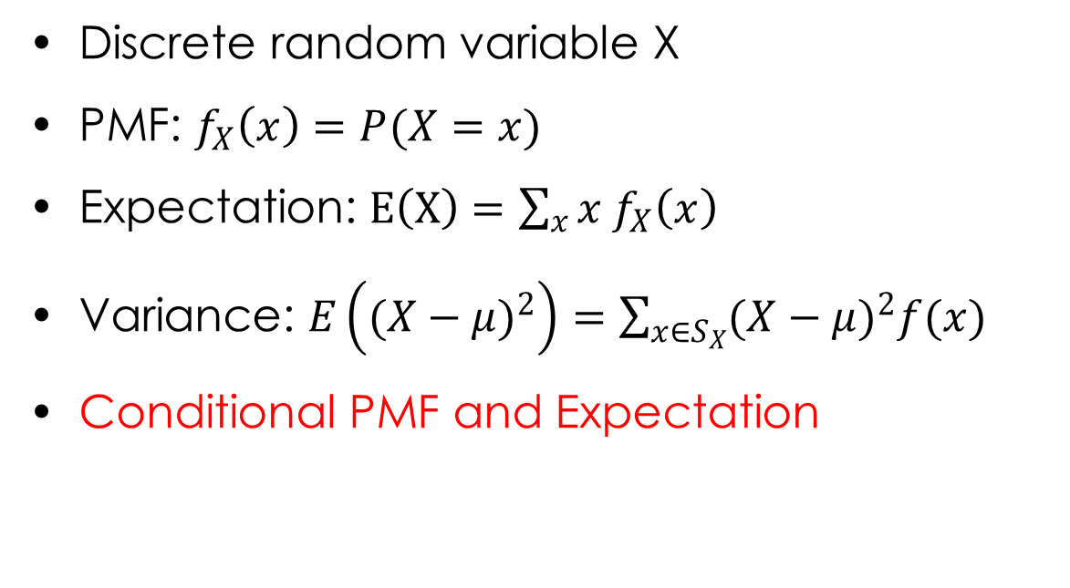
A Review
Discrete random variable X
PMF: $f_{X}\left(x\right)=P(X=x)$
Expectation: $E\left(X\right)=\sum_{x}{x f_{X}\left(x\right)}$
Variance: $E\left({(X−μ)}^{2}\right)=\sum_{x∈S_{X}}{{(X−μ)}^{2}f(x)}$
Conditional PMF and Expectation

Slide 4

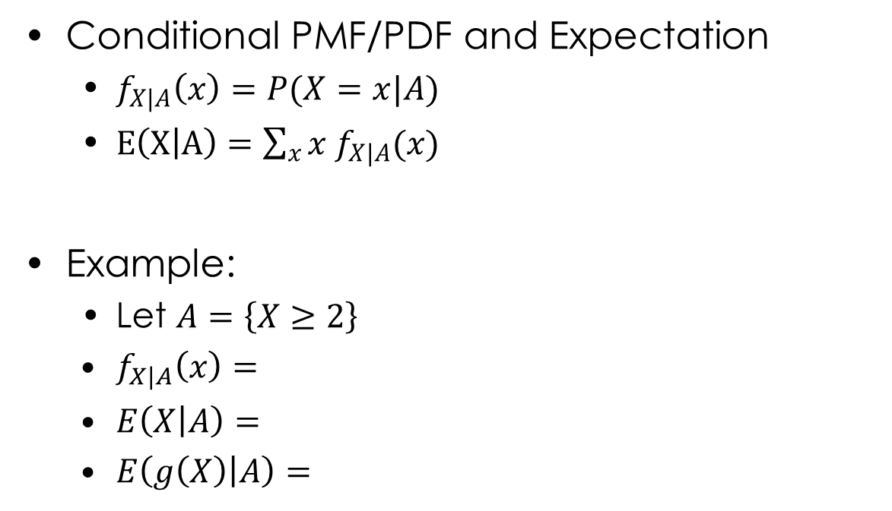
A Review
Conditional PMF/PDF and Expectation
$f_{X|A}\left(x\right)=P(X=x|A)$
$E\left(X | A\right)=\sum_{x}{x f_{X|A}(x)}$
Example:
Let $A=\left\{X≥2\right\}$
$f_{X|A}\left(x\right)=$
$E\left(X | A\right)=$
$E\left(g\left(X\right) | A\right)=$
$$f_{X}(x)$$
1/4
1
2
4
x
3

Slide 5
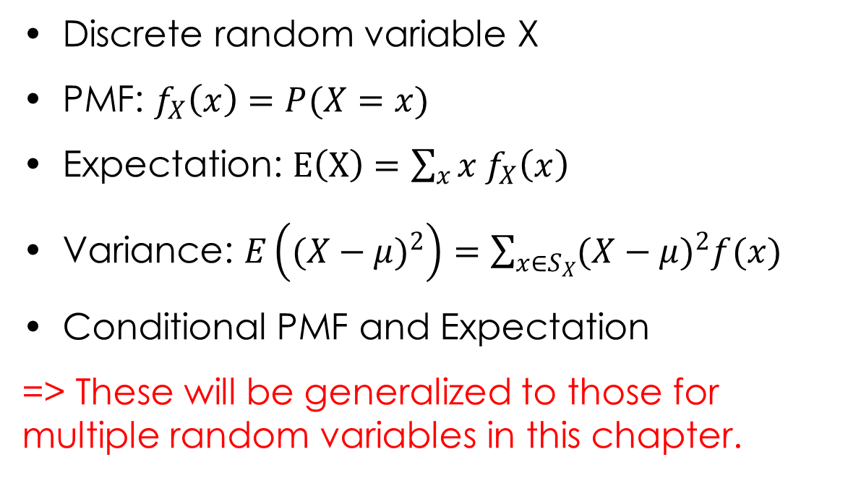
A Review
Discrete random variable X
PMF: $f_{X}\left(x\right)=P(X=x)$
Expectation: $E\left(X\right)=\sum_{x}{x f_{X}\left(x\right)}$
Variance: $E\left({(X−μ)}^{2}\right)=\sum_{x∈S_{X}}{{(X−μ)}^{2}f(x)}$
Conditional PMF and Expectation
=> These will be generalized to those for multiple random variables in this chapter.

Slide 6
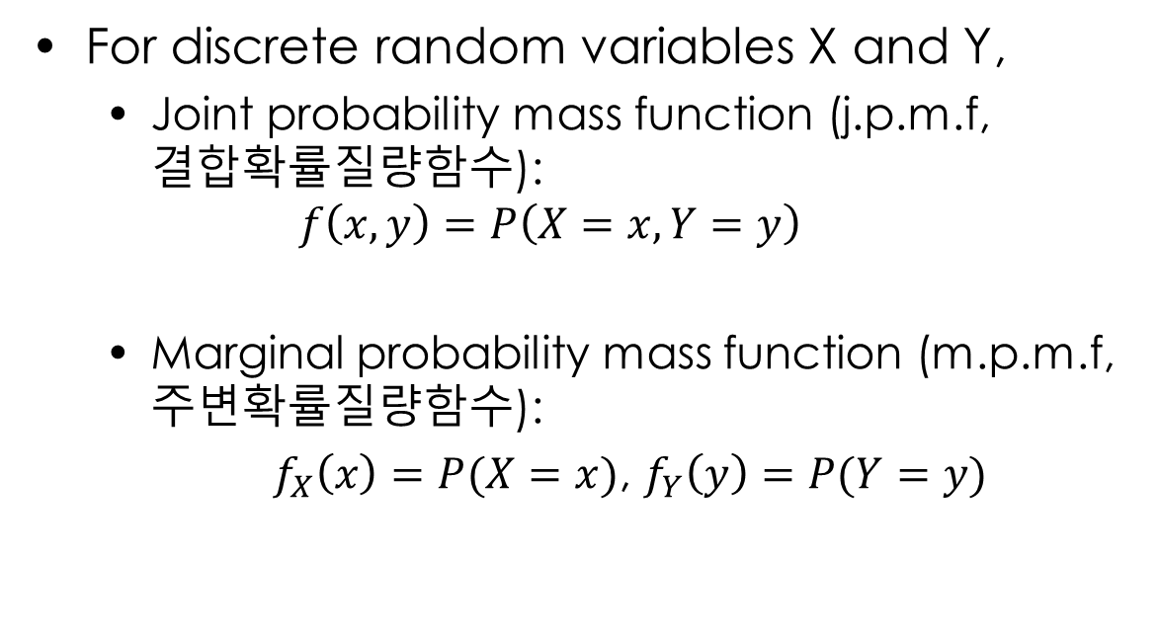
3.1 Joint Probability Distribution(결합확률분포)
For discrete random variables X and Y,
Joint probability mass function (j.p.m.f, 결합확률질량함수):
$$f\left(x,y\right)=P\left(X=x,Y=y\right)$$
Marginal probability mass function (m.p.m.f, 주변확률질량함수):
$f_{X}\left(x\right)=P(X=x)$, $f_{Y}\left(y\right)=P(Y=y)$

Slide 7

3.1 Joint Probability Distribution(결합확률분포)
Activity1 (예제2)
$f_{X,Y}\left(x,y\right)=P(X=x and Y=y)$
Is this PMF? $f_{X,Y}\left(3,2\right)?$
$f_{X}\left(x\right)$=? $f_{X}\left(3\right)$=?
$f_{Y}\left(x\right)$=? $f_{Y}\left(2\right)$=?
Y
 | 1 | 2 | 3
1 | 0.03 | 0.05 | 0.23
2 | 0.05 | 0.13 | 0.15
3 | 0.13 | 0.16 | 0.07
X

Slide 8
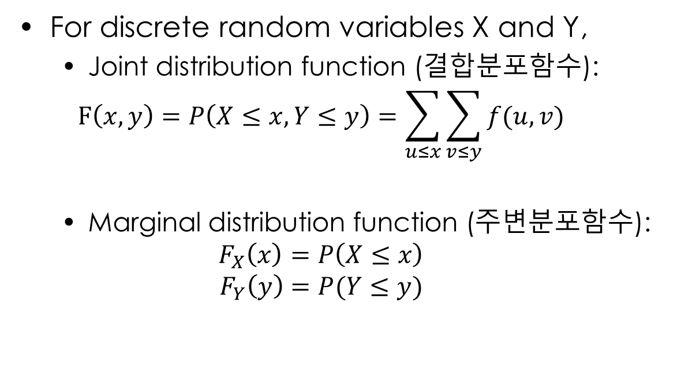
3.1 Joint Probability Distribution(결합확률분포)
For discrete random variables X and Y,
Joint distribution function (결합분포함수):
$$F\left(x,y\right)=P\left(X≤x,Y≤y\right)=\sum_{u≤x}{\sum_{v≤y}{f(u,v)}}$$
Marginal distribution function (주변분포함수):
$$F_{X}\left(x\right)=P\left(X≤x\right)$$
$$F_{Y}\left(y\right)=P(Y≤y)$$

Slide 9

3.1 Joint Probability Distribution(결합확률분포)
Activity2 (예제2)
$f_{X,Y}\left(x,y\right)=P(X=x and Y=y)$
$F\left(x,y\right)?$
$F_{X}\left(x\right)$?
$F_{Y}\left(x\right)$?
Y
 | 1 | 2 | 3
1 | 0.03 | 0.05 | 0.23
2 | 0.05 | 0.13 | 0.15
3 | 0.13 | 0.16 | 0.07
X

Slide 10
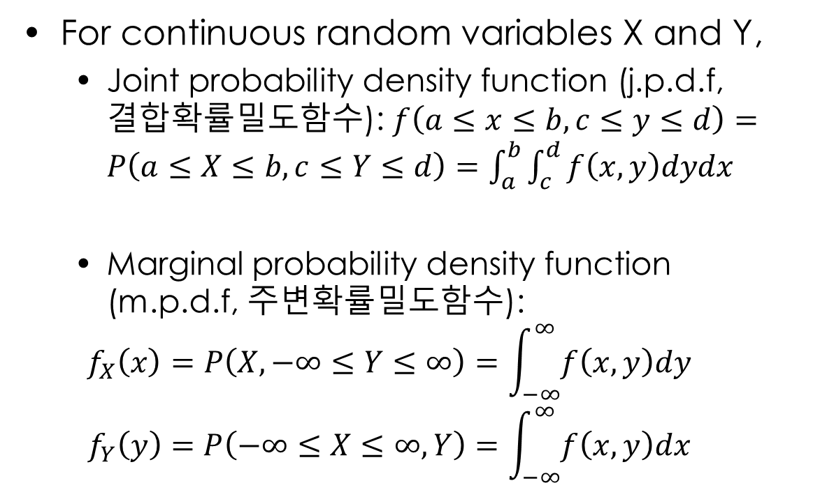
3.1 Joint Probability Distribution(결합확률분포)
For continuous random variables X and Y,
Joint probability density function (j.p.d.f, 결합확률밀도함수): $f\left(a≤x≤b,c≤y≤d\right)=P\left(a≤X≤b,c≤Y≤d\right)=\int_{a}^{b}{\int_{c}^{d}{f\left(x,y\right)dydx}}$
Marginal probability density function (m.p.d.f, 주변확률밀도함수):
$$f_{X}\left(x\right)=P\left(X,−∞≤Y≤∞\right)=\int_{−∞}^{∞}{f\left(x,y\right)dy}$$
$$f_{Y}\left(y\right)=P\left(−∞≤X≤∞,Y\right)=\int_{−∞}^{∞}{f\left(x,y\right)dx}$$

Slide 11
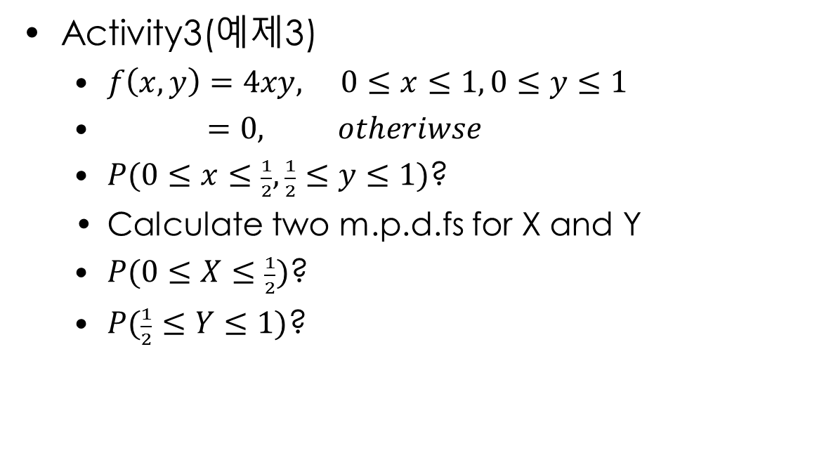
3.1 Joint Probability Distribution(결합확률분포)
Activity3(예제3)
$f\left(x,y\right)=4xy, 0≤x≤1, 0≤y≤1$
$=0, otheriwse$
$P(0≤x≤\frac{1}{2}, \frac{1}{2}≤y≤1)$?
Calculate two m.p.d.fs for X and Y
$P(0≤X≤\frac{1}{2})$?
$P(\frac{1}{2}≤Y≤1)$?

Slide 12
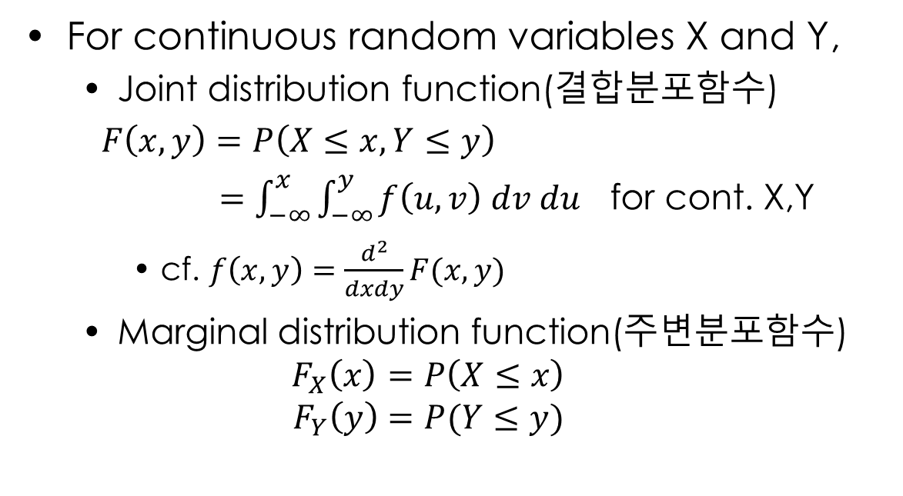
3.1 Joint Probability Distribution(결합확률분포)
For continuous random variables X and Y,
Joint distribution function(결합분포함수)
$F\left(x,y\right)=P\left(X≤x,Y≤y\right)$
$=\int_{−∞}^{x}{\int_{−∞}^{y}{f\left(u,v\right) dv du}}$ for cont. X,Y
cf. $f\left(x,y\right)=\frac{d^{2}}{dxdy}F(x,y)$
Marginal distribution function(주변분포함수)
$$F_{X}\left(x\right)=P\left(X≤x\right)$$
$$F_{Y}\left(y\right)=P(Y≤y)$$

Slide 13
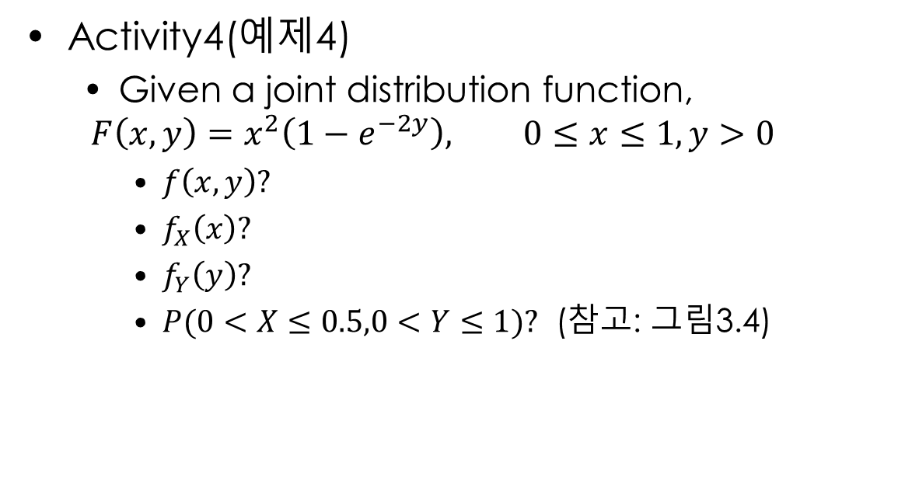
3.1 Joint Probability Distribution(결합확률분포)
Activity4(예제4)
Given a joint distribution function,
$$F\left(x,y\right)=x^{2}\left(1−e^{−2y}\right), 0≤x≤1, y>0$$
$f\left(x,y\right)?$
$f_{X}\left(x\right)?$
$f_{Y}\left(y\right)?$
$P(0<X≤0.5,0<Y≤1)?$ (참고: 그림3.4)

Slide 14
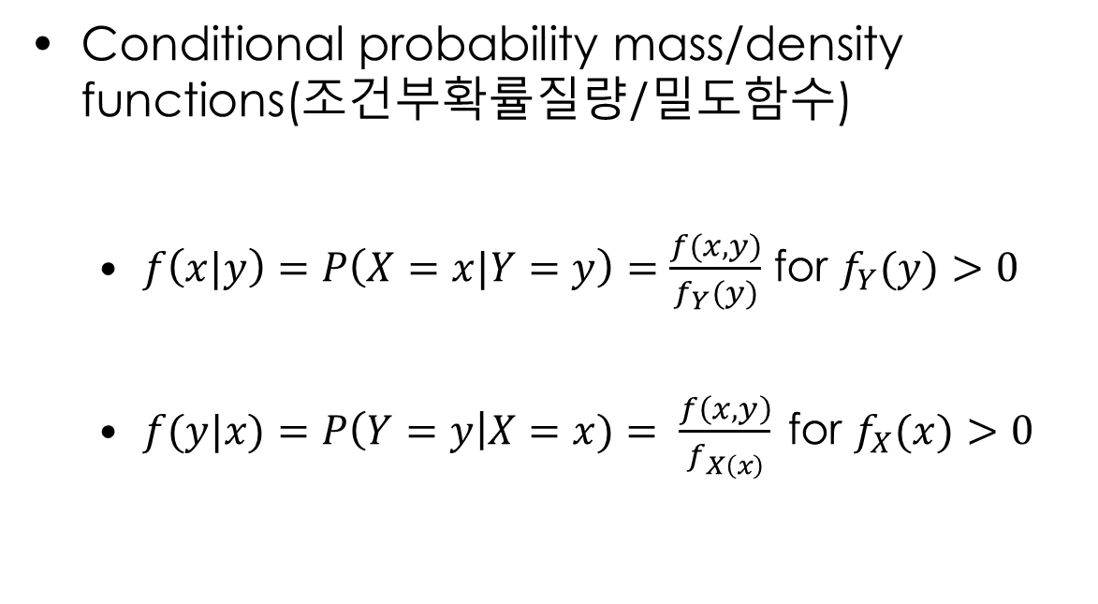
3.2 Conditional Probability Distribution (조건부 확률분포)
Conditional probability mass/density functions(조건부확률질량/밀도함수)
$f\left(x|y\right)=P\left(X=x|Y=y\right)=\frac{f(x,y)}{f_{Y}(y)}$ for $f_{Y}(y)>0$
$f(y|x)=P\left(Y=y\right|X=x)= \frac{f\left(x,y\right)}{f_{X\left(x\right)}} \text{for} f_{X}(x)>0$

Slide 15
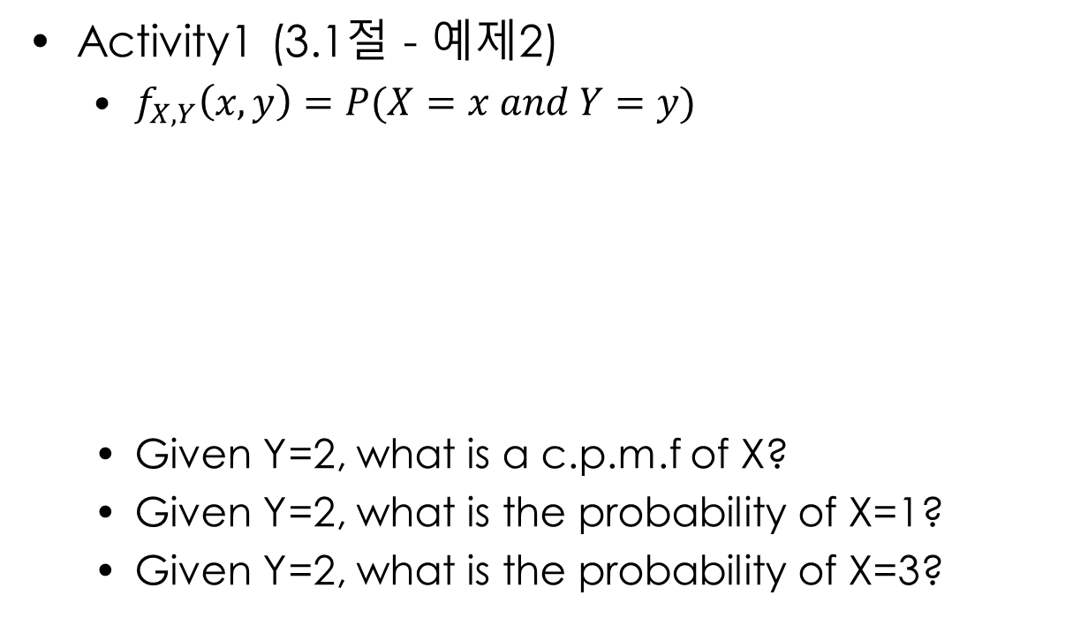
3.2 Conditional Probability Distribution (조건부 확률분포)
Activity1 (3.1절 - 예제2)
$f_{X,Y}\left(x,y\right)=P(X=x and Y=y)$
Given Y=2, what is a c.p.m.f of X?
Given Y=2, what is the probability of X=1?
Given Y=2, what is the probability of X=3?
Y
 | 1 | 2 | 3
1 | 0.03 | 0.05 | 0.23
2 | 0.05 | 0.13 | 0.15
3 | 0.13 | 0.16 | 0.07
X

Slide 16
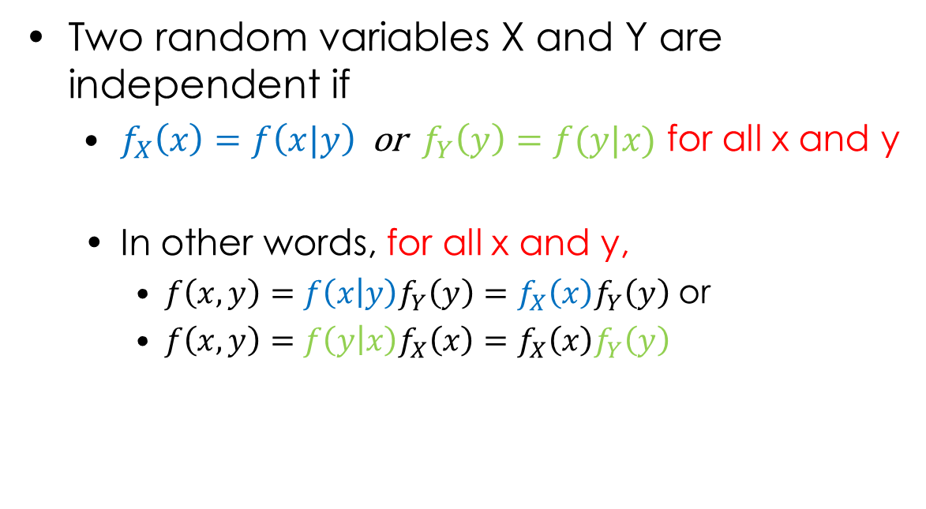
3.2 Conditional Probability Distribution (조건부 확률분포)
Two random variables X and Y are independent if
$f_{X}\left(x\right)=f\left(x|y\right)$ or $f_{Y}\left(y\right)=f(y|x)$ for all x and y
In other words, for all x and y,
$f\left(x,y\right)=f\left(x | y\right)f_{Y}\left(y\right)=f_{X}\left(x\right)f_{Y}\left(y\right)$ or
$f\left(x,y\right)=f\left(y | x\right)f_{X}\left(x\right)=f_{X}\left(x\right)f_{Y}\left(y\right)$

Slide 17

3.2 Conditional Probability Distribution (조건부 확률분포)
Activity2
3.2절 예제4-(1), 예제3
3.1절 예제2
$f_{X,Y}\left(x,y\right)=P(X=x and Y=y)$
Are X and Y independent with each other?
 | 1 | 2 | 3
1 | 0.03 | 0.05 | 0.23
2 | 0.05 | 0.13 | 0.15
3 | 0.13 | 0.16 | 0.07
X
Y

Slide 18
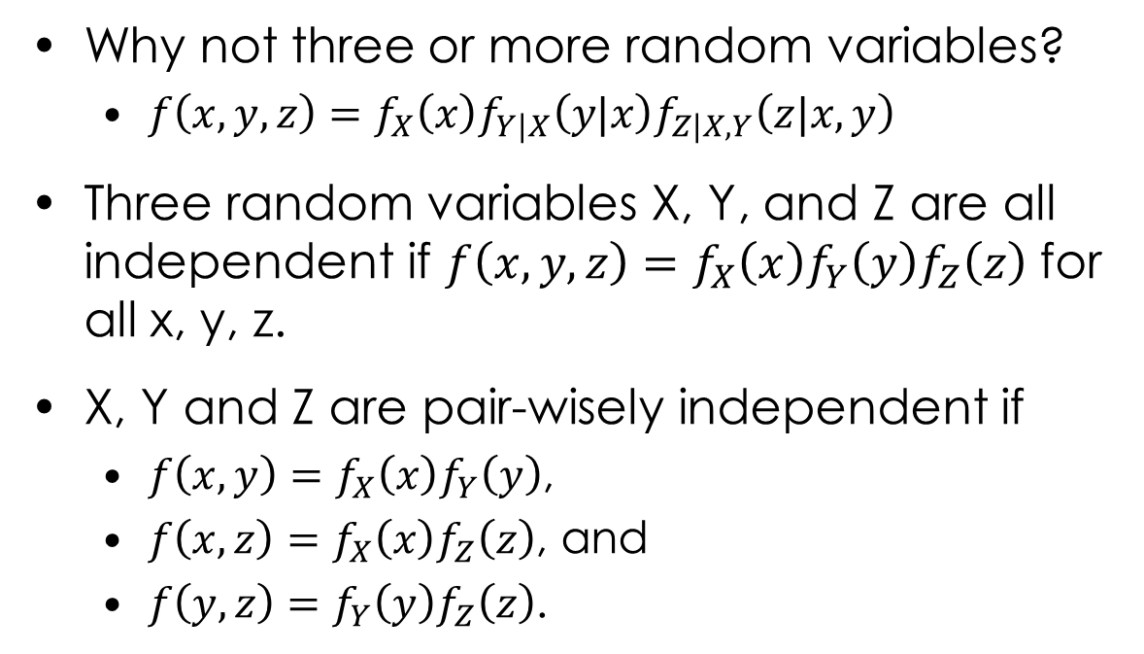
3.2 Conditional Probability Distribution (조건부 확률분포)
Why not three or more random variables?
$f\left(x,y,z\right)=f_{X}\left(x\right)f_{Y|X}\left(y|x\right)f_{Z|X,Y}\left(z|x,y\right)$
Three random variables X, Y, and Z are all independent if $f\left(x,y,z\right)=f_{X}\left(x\right)f_{Y}\left(y\right)f_{Z}\left(z\right)$ for all x, y, z.
X, Y and Z are pair-wisely independent if
$f\left(x,y\right)=f_{X}\left(x\right)f_{Y}\left(y\right)$,
$f\left(x,z\right)=f_{X}\left(x\right)f_{Z}\left(z\right)$, and
$f\left(y,z\right)=f_{Y}\left(y\right)f_{Z}\left(z\right)$.

Slide 19
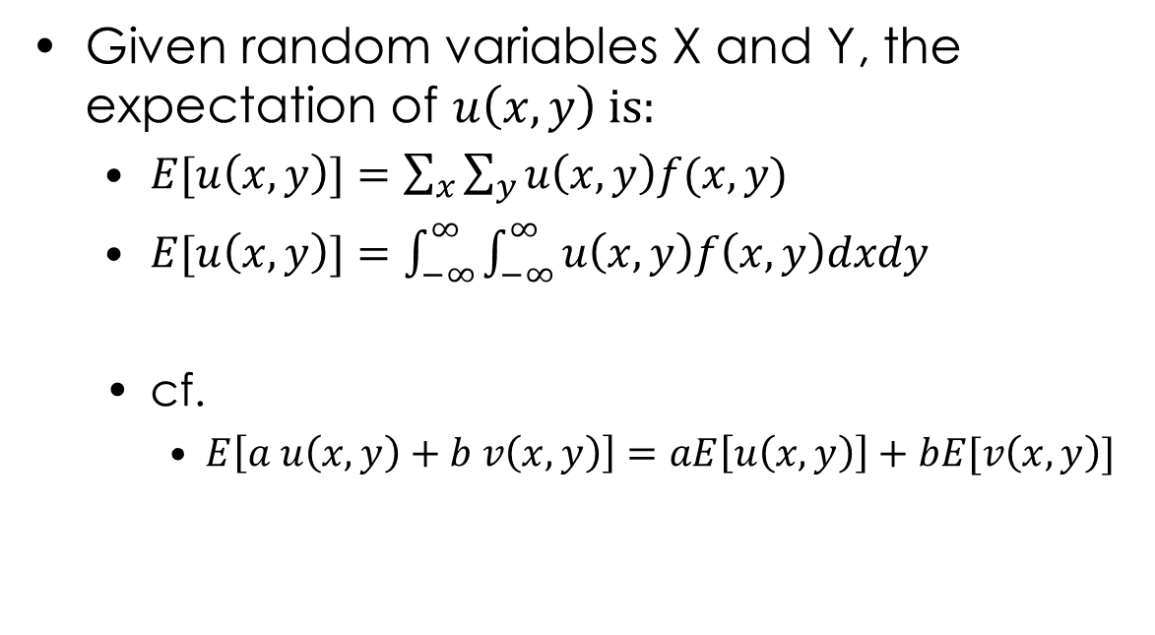
3.3 Expectation in Joint Probability Distribution (결합분포에 대한 기댓값)
Given random variables X and Y, the expectation of $u\left(x,y\right)$ is:
$E[u\left(x,y\right)]=\sum_{x}{\sum_{y}{u\left(x,y\right)f(x,y)}}$
$E[u\left(x,y\right)]$ $=\int_{−∞}^{∞}{\int_{−∞}^{∞}{u\left(x,y\right)f\left(x,y\right)dxdy}}$
cf.
$E\left[a u\left(x,y\right)+b v\left(x,y\right)\right]=aE\left[u\left(x,y\right)\right]+bE[v\left(x,y\right)]$

Slide 20
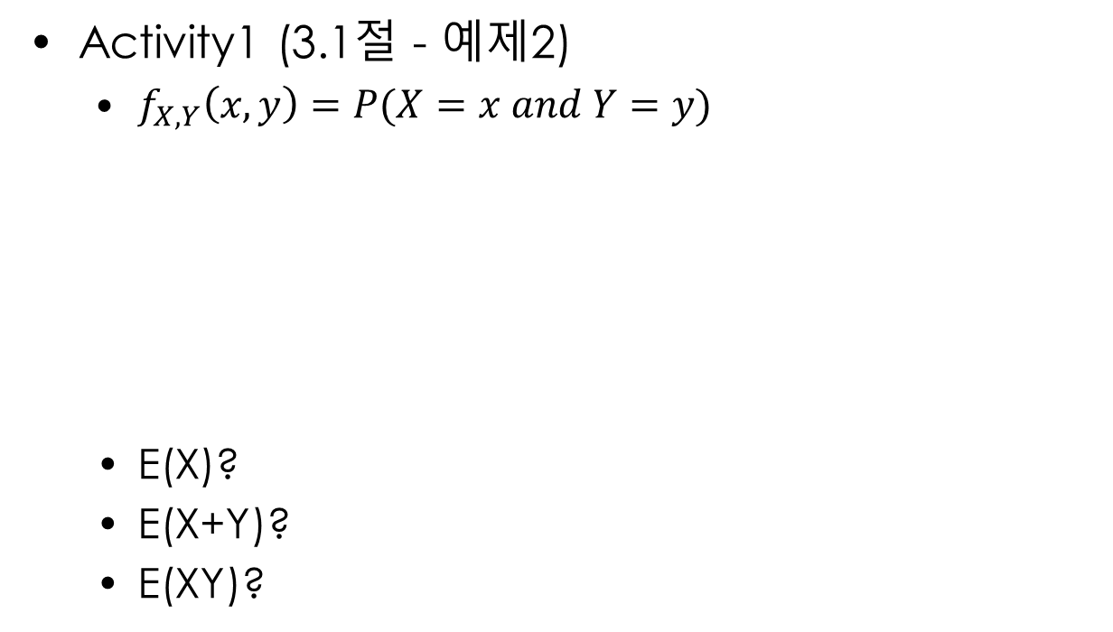
3.3 Expectation in Joint Probability Distribution (결합분포에 대한 기댓값)
Activity1 (3.1절 - 예제2)
$f_{X,Y}\left(x,y\right)=P(X=x and Y=y)$
E(X)?
E(X+Y)?
E(XY)?
Y
 | 1 | 2 | 3
1 | 0.03 | 0.05 | 0.23
2 | 0.05 | 0.13 | 0.15
3 | 0.13 | 0.16 | 0.07
X

Slide 21
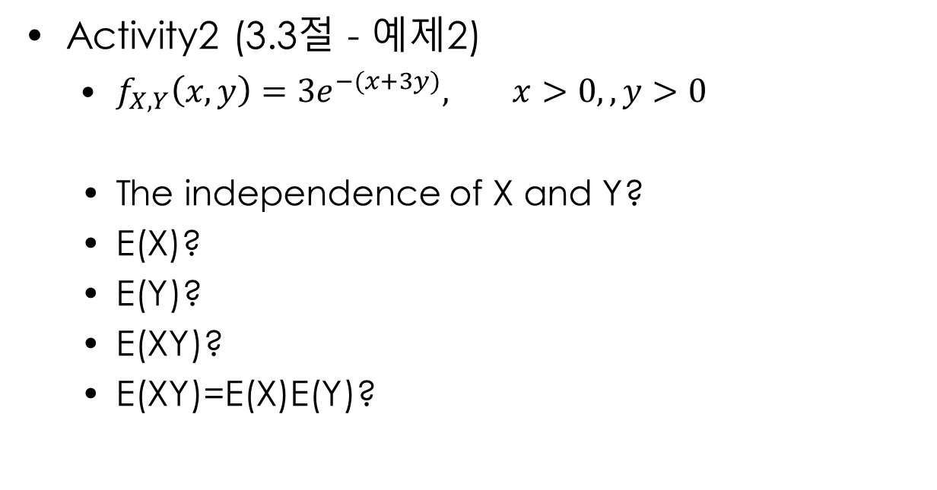
3.3 Expectation in Joint Probability Distribution (결합분포에 대한 기댓값)
Activity2 (3.3절 - 예제2)
$f_{X,Y}\left(x,y\right)=3e^{−(x+3y)}, x>0,,y>0$
The independence of X and Y?
E(X)?
E(Y)?
E(XY)?
E(XY)=E(X)E(Y)?

Slide 22
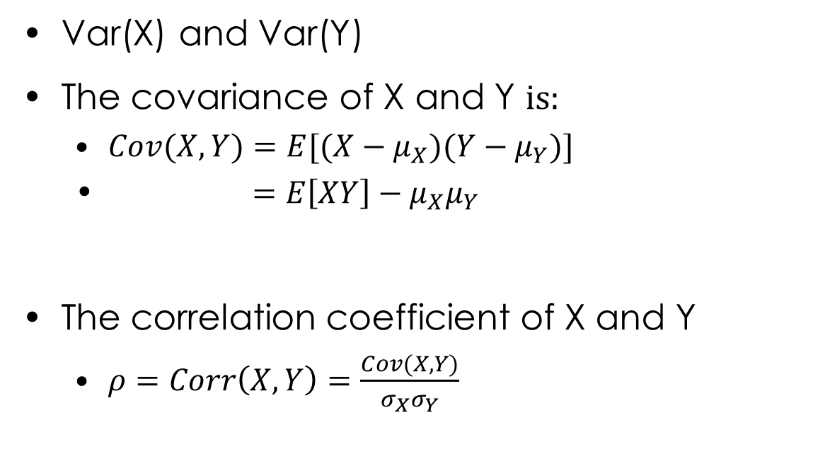
3.3 Expectation in Joint Probability Distribution (결합분포에 대한 기댓값)
Var(X) and Var(Y)
The covariance of X and Y is:
$Cov(X,Y)=E[(X−μ_{X})(Y−μ_{Y})]$
$=E\left[XY\right]−μ_{X}μ_{Y}$
The correlation coefficient of X and Y
$ρ=Corr\left(X,Y\right)=\frac{Cov(X,Y)}{σ_{X}σ_{Y}}$

Slide 23

3.3 Expectation in Joint Probability Distribution (결합분포에 대한 기댓값)
Activity3 (3.1절 - 예제2)
$f_{X,Y}\left(x,y\right)=P(X=x and Y=y)$
Cov(X,Y)?
Corr(X,Y)?
Y
 | 1 | 2 | 3
1 | 0.03 | 0.05 | 0.23
2 | 0.05 | 0.13 | 0.15
3 | 0.13 | 0.16 | 0.07
X

Slide 24
What we have learned
How to calculate probability when multiple random variables are involved
Joint Probability Distribution
Conditional Probability Distribution
Expectation in Joint Probability Distribution

